Slide 1

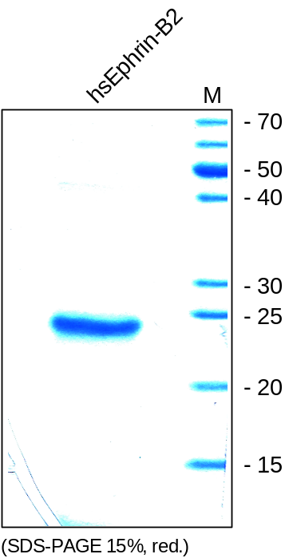
ReliaTech GmbH
Recombinant human soluble Ephrin-B2
(Cat # S01-068S / S01-068)
Fig. 1: SDS-PAGE analysis of recombinant human soluble Ephrin-B2 produced in E. coli. Sample was loaded in 15% SDS-polyacrylamide gel under reducing conditions and stained with Coomassie blue.
http://www.reliatech.de / orders@reliatech.de

